Slide 1
TRADITIONS
By: Siddharth Pandya
Roll No. : 23
Sap Id: 70362019040

Slide 2
1.List all the traditions that your personally follow throughout the year with your family and friends.
Festival Tradition:
1)Diwali​
2)Holi​
3)Navratri​
4)Janmashtami​
5)Ganesh Chaturthi​
6)Christmas​
7)Raksha Bandhan​
8)Eid​
9)Makarsankranti​
10)New Year

Slide 3
Life Changes/Milestone Traditions:
New Home Dedication.
Family Time Capsule.
School-Related Traditions:
First Day of School Photos.
Parent/Teacher Conference Note.
Birthday Traditions:
First Cake Cut Wish.
8^{th/} 18th Birthday Time Capsule.
Miscellaneous Hindu Traditions:
Jatakarma/Celebrating birth
Namakarana/Giving a name
Antyeshti/Funeral rites
Mundun/Shaving the head

Slide 4
2.Out of the ones you listed, identify FIVE of them that you genuinely follow for your own reasons.
1) Antyeshti/Funeral rites
2) Mundun/Shaving the head
3) Ganesh Chaturthi
4) Jatakarma/Celebrating birth
5) Namakarana/Giving a name

Slide 5
3.For each of the FIVE, write a small essay of 5 lines explaining why that tradition appeals to you?
1) Antyeshti/Funeral rites - Upon death of the person, the dead body is typically consigned to flames on a wooden pyre. The rituals accompanying the death go on for thirteen days after the death.
2) Mundun/Shaving the head - When the child is a year old, the head is shaved and nails are cut. This rite symbolises the child's entry into personal hygiene.
3) Ganesh Chaturthi -​
Hindu festival celebrated on the occasion of birthday of Lord Ganesha.​
Best of his presence on earth for all his devotees.​
Ganesh Chaturthi is a ten-day celebration.​
It is held between 19 August and 15 September and ends on Anant Chaturdash.​

Slide 6
Reason For Celebrating Ganesh Chaturthi:-​
The excitement for this 10-day long festival begins weeks before Ganesh Chaturthi people making clay idols of Lord Ganesha and painting them.​
Ganesh Chaturthi is known to be celebrated in a large way in Maharashtra and Andhra Pradesh but this festival is spread all over India for equal favour and happiness.​
People also sometimes choose to bring Ganpati home ahead of the festival and host him for the 10-day festivities.​
On the tenth day, Lord Ganesha’s statue is immersed in water, known as Ganpati Visarjan.​
Devotees chant Ganapati Bappa Morya, paying respect to him as he is seen off, taking all our worries away and leaving blessings behind.

Slide 7
4) Jatakarma/Celebrating birth : Once the child is born, a ritual is performed to welcome the child to the world. The father whispers a prayer into the ear of the newborn, telling the child to suck the truth as if it were his mother's milk.
5) Namakarana/Giving a name : On the tenth or eleventh day after birth, the relatives and friends come together; during this ceremony the name of the child is formally announced.

Slide 8
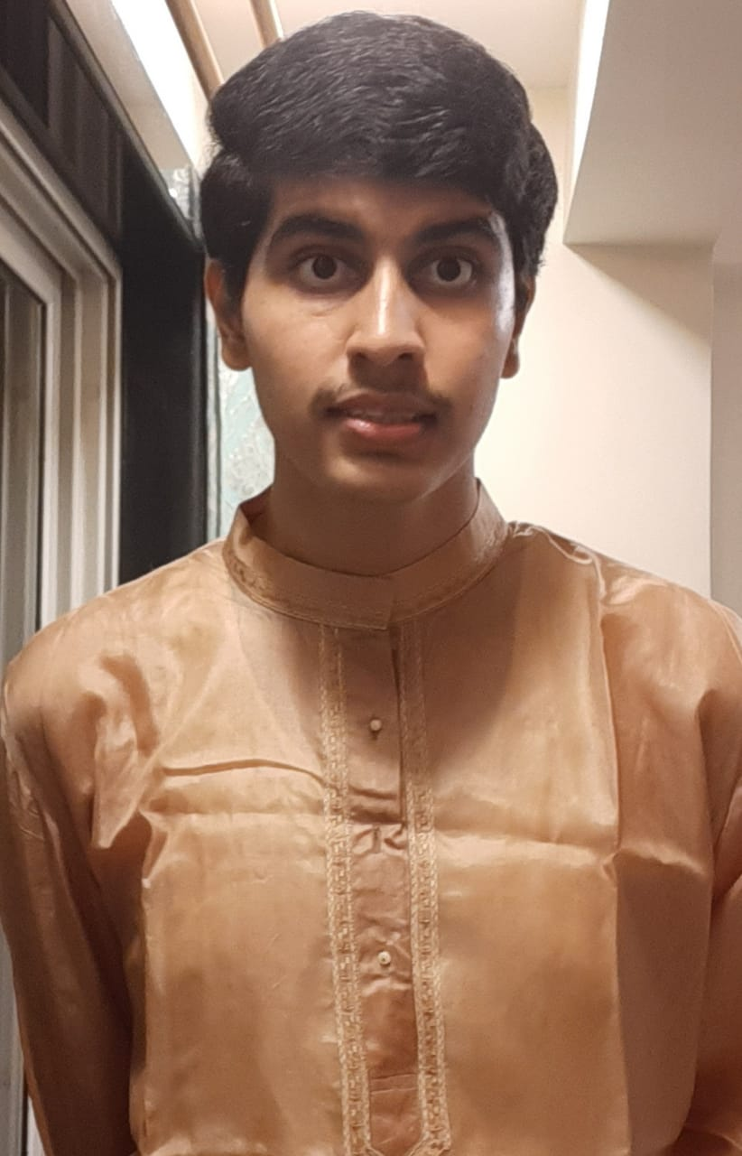
4.Include your full length photograph in your traditional dress and give a short description of it’s significance
Diwali​ : Diwali is the most important festival in India.​
It is also known as Festival of Lights. Indians pay tribute to Lakshmi, the goddess of wealth by lit candles and colourful rangoli artworks on floor in Diwali.​
Diwali festival lasts 5 days,It is Named after the Hindu calendar: ​
Day 1. Vasu Baras ​
Day 2. Dhan Teras​
Day 3. Kali Chaudas or Chaturdashi​
Day 4. Diwali/ Deepawali or Lakshmi Puja​
Day 5. Govardhan Puja​

Slide 9
Reason for celebrating Diwali:-​
It is regarded as victory of good over evil.​
Hindus celebrate the birth of the goddess Lakshmi and her marriage to Lord Vishnu on Diwali and seek her blessings for the coming year. ​
People decorate their house with Rangoli and lights.​

Slide 10
Thank You

